Slide 1
NCD’s & Migration:
Mexico and Central America
May 2025

Slide 2
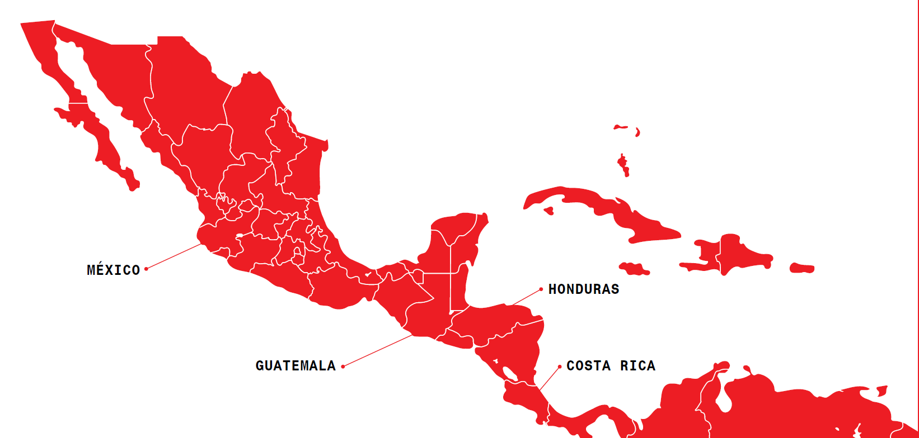
Regional MIGRATION INITIATIVE

Slide 3
Regional intervention to provide care for PoM since 2021.
Care focused on victims of violence to care for the population on the move (PoM).
Services adapted to the specific characteristics of each point: PHC, MH, SW, HP, CM, WASH.

Slide 4
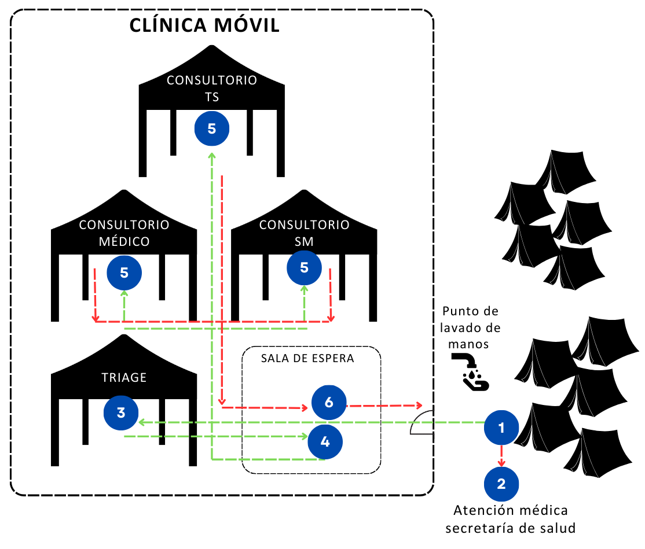
Mexico City Project Activities
Mental Health
Psychological care mhGAP
SRH
ANC
SAC
Social Work
Health promotion
Intercultural mediation
Access to health services Response to socioeconomic needs through social plans
interpretation
Case identification Education and information: SRH, mental health, activities with children, access to services.
PHC
High risk infectious diseases
NCD’s
improving culturally adapted services
information and orientation);
SV and GBV Care

Slide 5
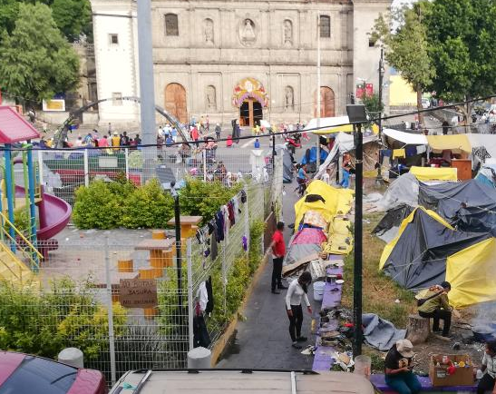
Context Considerations in NCD’s
Limited access to medications.
Theft or confiscation of medications at borders.
Irregular access to food.
Barriers to receiving care for medical complications.
Lack of family or financial support networks.
Living conditions in Mexico City.
The expected follow-up period for patients is short (consultations with no guarantee of continuity).
Notes:
Referencia (warm referral) ≠ Orientación​

Slide 6
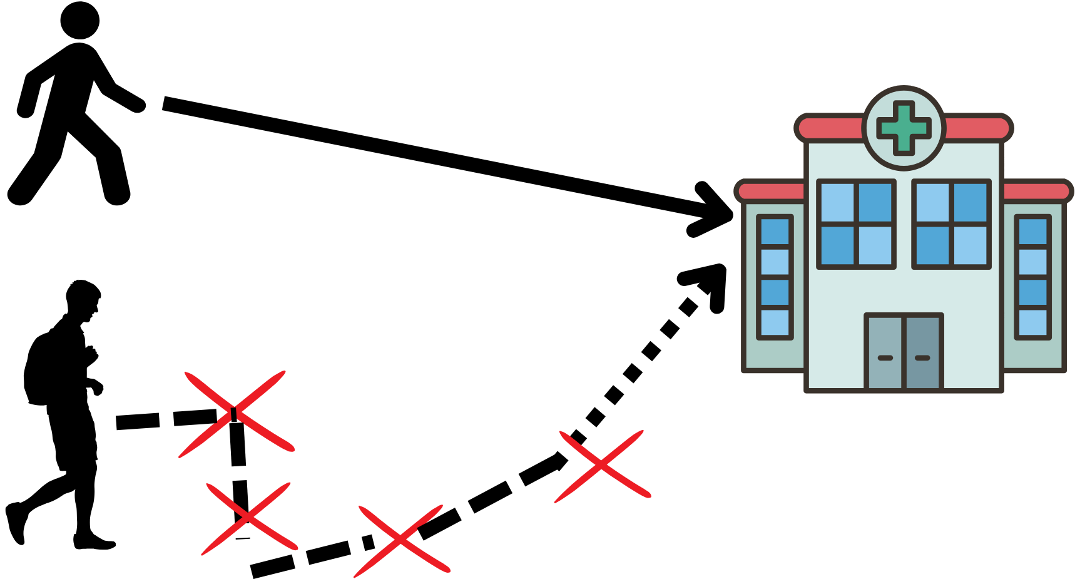
Barriers to accessing NCD care for PoM: Health inequalities and inequities
Health inequalities:
Differences in health status or in the distribution of health determinants between different population groups (WHO 2018).
Health inequities:
Health inequities invoke the concepts of fairness and being avoidable and thus are ‘unfair and could be reduced by the right mix of government policies’ (WHO 2018)
Lack of availability of comprehensive care services.
Lack of information on health services available
Requirement to present “official” documents in order to access medical care
Food insecurity
Racism
Discrimination
Language
Poor living conditions in camps and shelters

Slide 7
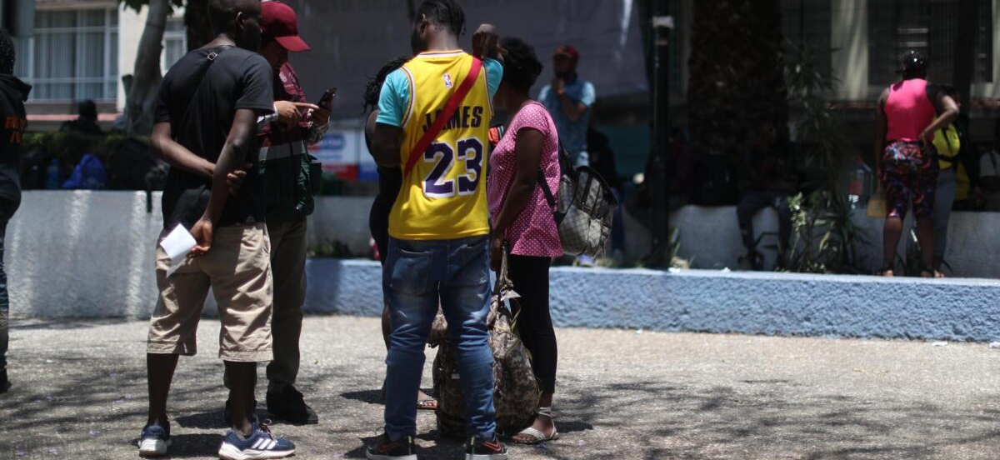
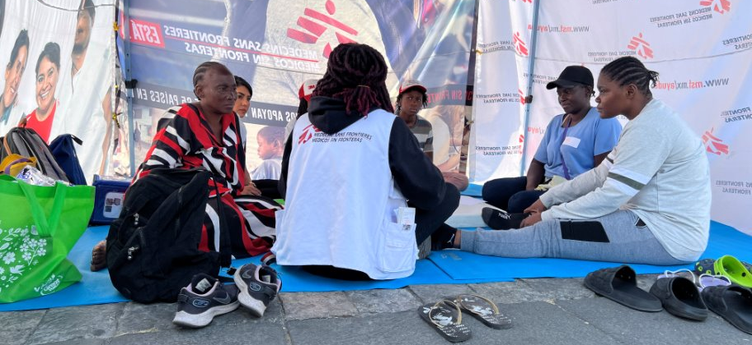
MSF Strategies¹
Case management and continuity of treatment with medications that cannot be interrupted without risk of mortality or disability should be prioritized. These include insulin, antiepileptic drugs, asthma and COPD treatments, anticoagulants, medications for heart failure, steroids for conditions such as severe asthma, and antipsychotics.
Health promotion activities related to non-communicable diseases (NCDs) can focus on immediate needs.
Definition of a minimum standard list (MSL) and care package based on drug availability within MSF, the public health system, and referral capacity.
Preparation for departure:
Travel medicine kit
Referral sheet with key clinical information and guidance on what to do upon arrival in the destination country or a more stable context.
1 Migration Health, Médecins Sans Frontières – OCB – 2021

Slide 8
Q&A

