Slide 2
Parents want eco-friendly baby items.
Buying #secondhandfirst is the most ecological option.
BUT
Buying second-hand is inconvenient and time-consuming.
There is a perception that second-hand items are dirty and low-quality.

Slide 3
SOlution: treehousecircular.com
A place to buy high-quality, eco-friendly, cleaned and tested secondhand (and new) baby items.
A place to sell your eco-friendly used baby items for a premium price.
Unlike the chaos of facebook marketplace or charity shops, we curate. We have items you actually want.
We are digital-native only with convenient shipping and delivery options throughout Switzerland

Slide 4
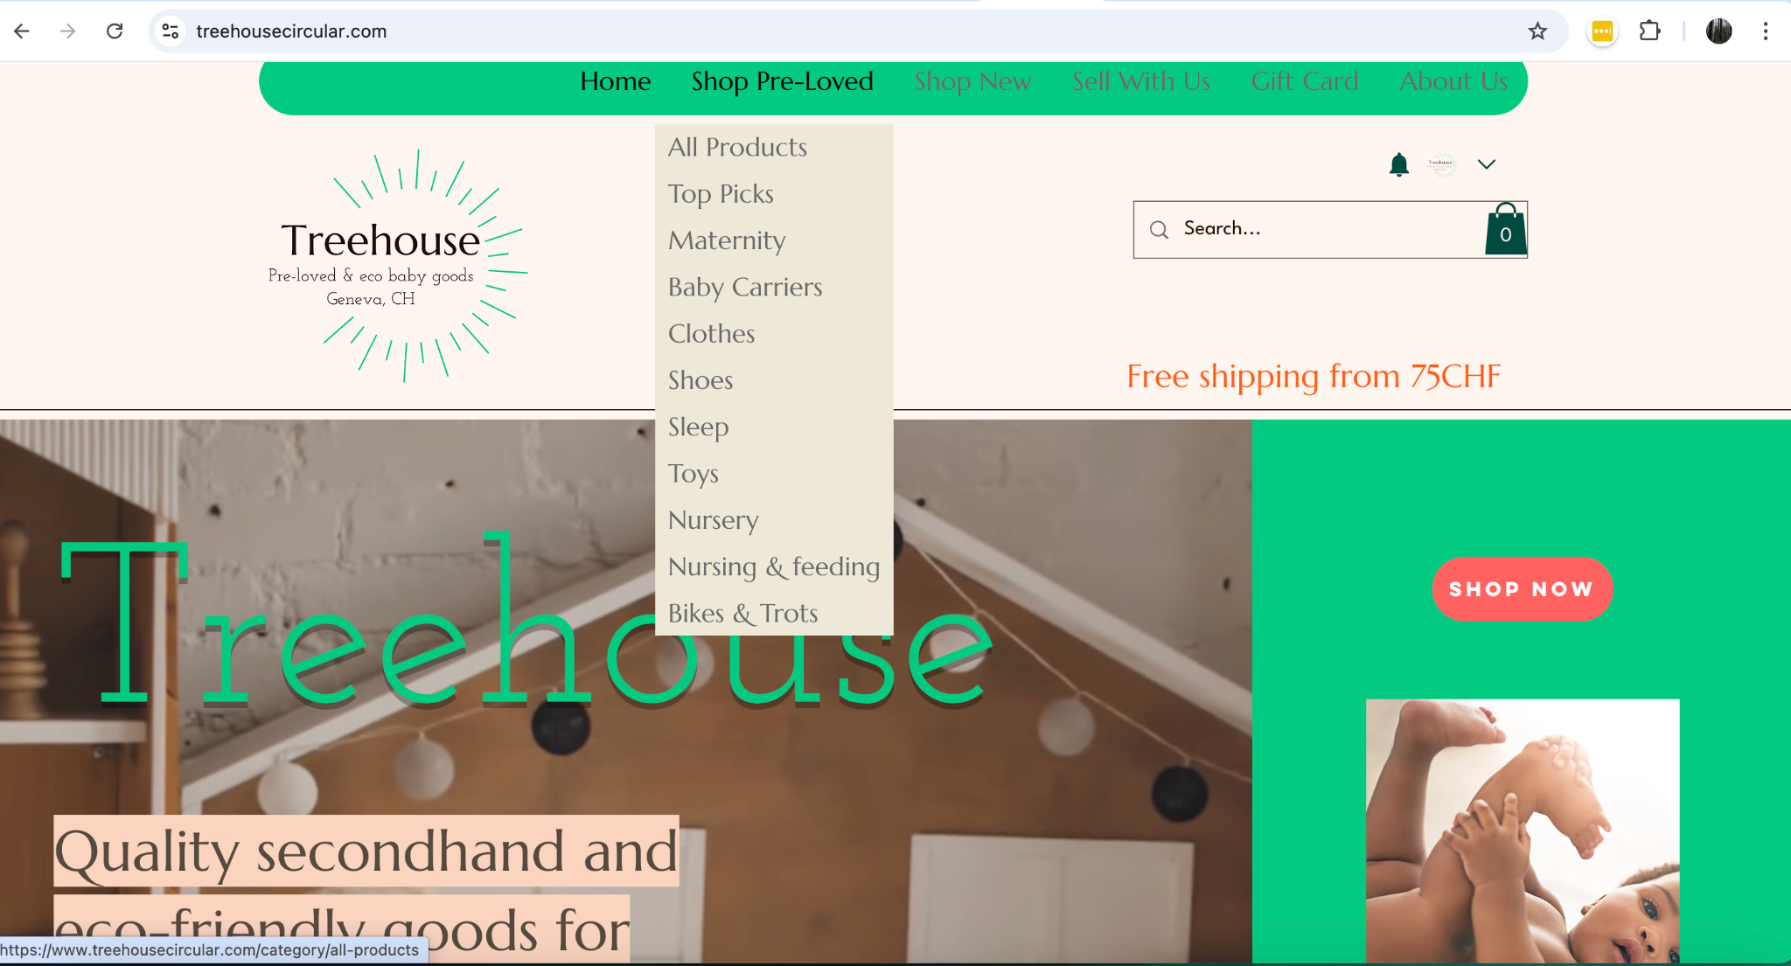
Website: treehousecircular.com

Slide 5
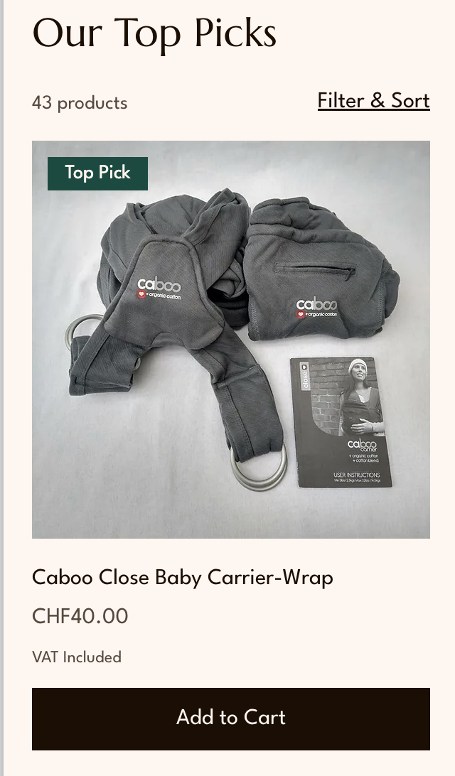
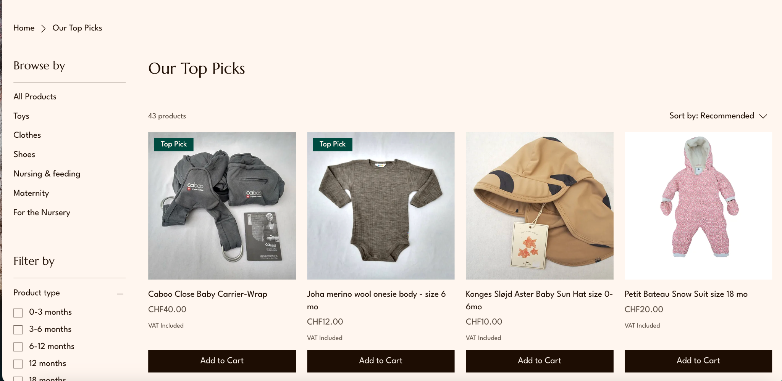
Shop: mobile & desktop

Slide 6
We focus on the customer journey.
Eco-conscious parents often start out looking for second-hand options, then move to looking at new items when they can’t find what they’re looking for.

Slide 7
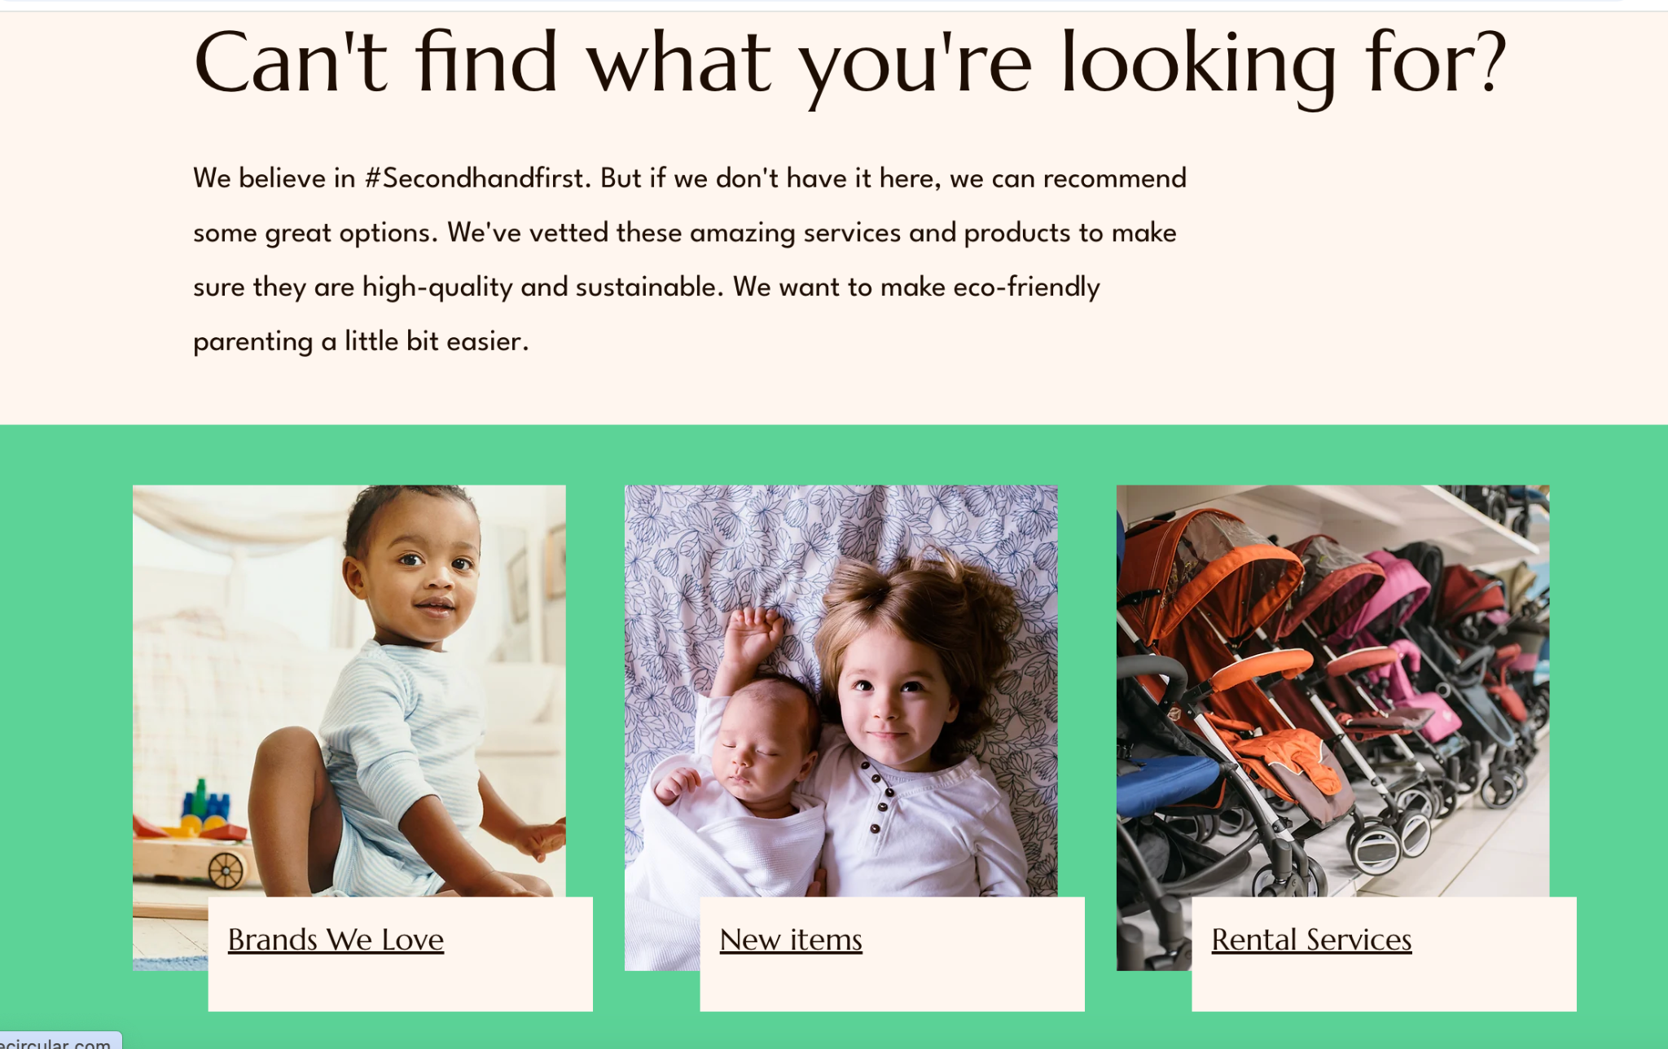
Collaboration before competition
Bottom of web-shop page

Slide 8
COMPETITION/USP
Features For BUYERS | Treehouse | Facebook Market- place | Petit Marché | Caritas/ Emmaus/ (charity shops) | Whatsapp (social buying & selling)
Focus on eco-friendly products | Yes | No | No | No | No
Secondhand AND new (eco-friendly) options | Yes | No | No | No | No
Curated, boutique experience | Yes | No | Yes | No | No
“Give back” aspect (5% of profits to fight climate-change ) | Yes | No | No | Yes | No
Shipping | Yes | Sometimes | Sometimes | No | Sometimes
Online | Yes | Yes | Yes | No | Yes

Slide 9
COMPETITION/USP
Features For SELLERS | Treehouse | Facebook Market- place | Petit Marché | Caritas/ Emmaus/ etc (charity shops) | Whatsapp (social buying & selling)
We pick up items, do all work for you | Yes | No | Sometimes | No | No
“Give back” aspect (5% of profits to fight climate-change) Option to donate your profits to partner charity | Yes | No | No | Yes | No
Seller makes more profit | No | Yes | Yes | No | Yes

Slide 10
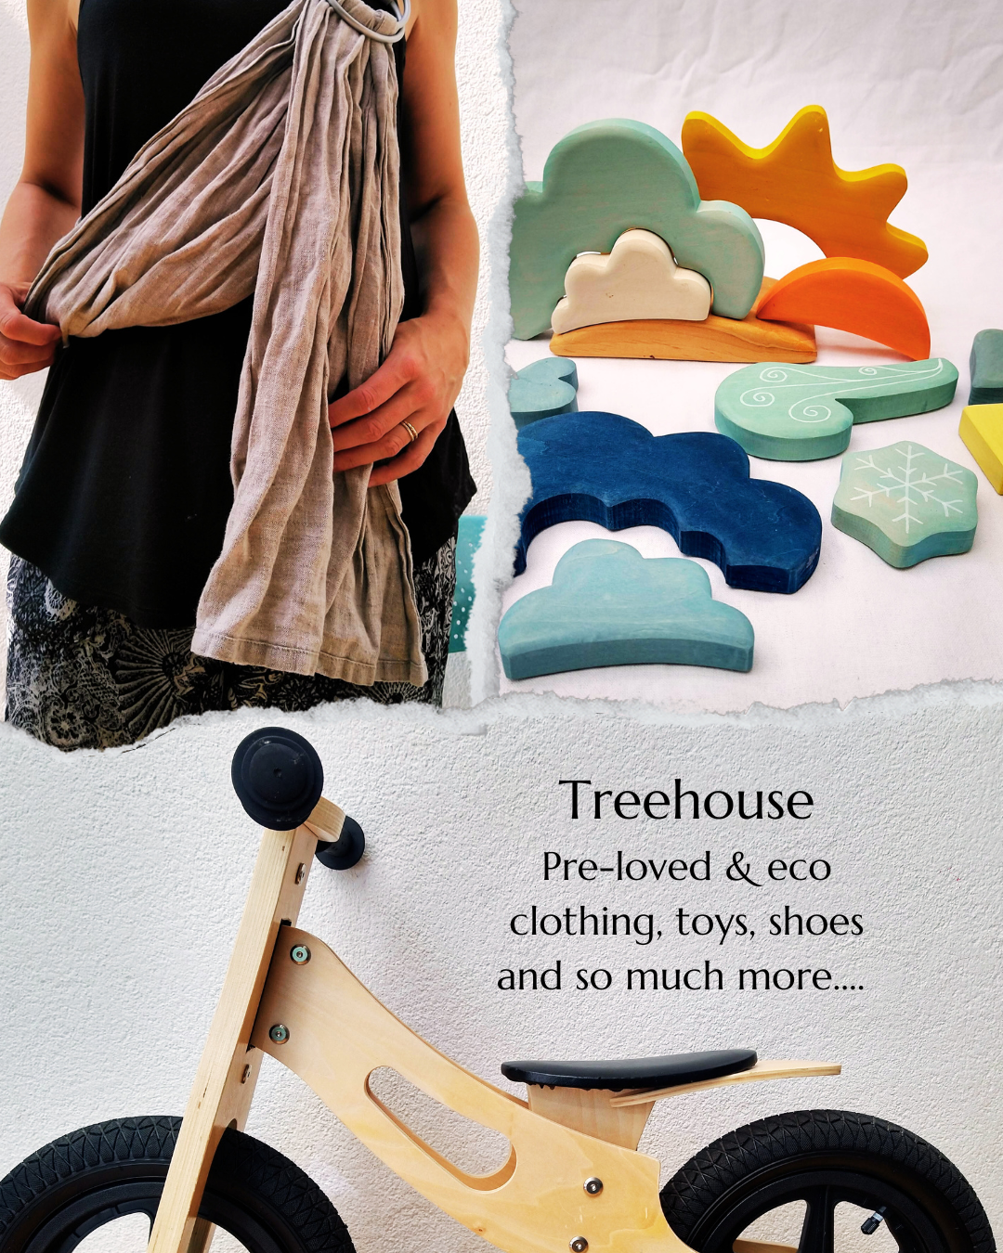
www.treehousecircular.com (launching Nov 1)
@treehousecircular

