Slide 1
Brand Name:

Slide 2
Segmentation
Demographic:
Geographic:
Behavioural:
Pyschpgraphic:

Slide 3
Target Audience

Slide 4
Differentiation / Competitive Advantages

Slide 5
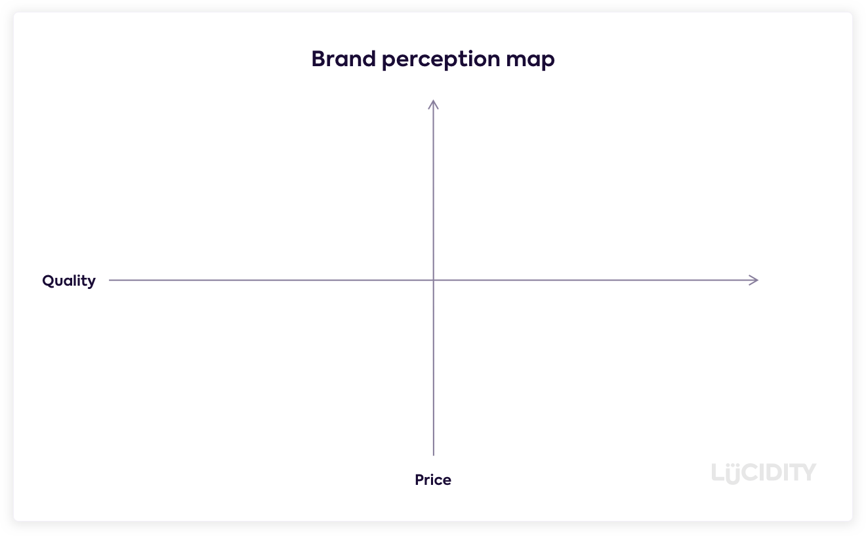
Positioning Map

Slide 6
Positioning Statement
To or For (target segment and need) ….
our (brand) is (concept/purpose) ….
that (points of difference) ….
Notes:
The company and brand positioning should be summed up in a positioning statement. An example using the above form is shown on the next slide.
The case for the brand’s superiority is made on its points of difference. For example, the U.S. Postal Service ships packages just like UPS and FedEx, but it differentiates its priority mail from competitors with convenient, low-price, flat-rate shipping boxes and envelopes. “If it fits, it ships,” promises USPS.

Slide 7
Brand Promise
Notes:
The company and brand positioning should be summed up in a positioning statement. An example using the above form is shown on the next slide.
The case for the brand’s superiority is made on its points of difference. For example, the U.S. Postal Service ships packages just like UPS and FedEx, but it differentiates its priority mail from competitors with convenient, low-price, flat-rate shipping boxes and envelopes. “If it fits, it ships,” promises USPS.

