Slide 1
Chapter 7: Marketing strategy part 2 DIFFERENTIATION & POSITIONING
Marketing Principles 1
Anna Wehren

Slide 2
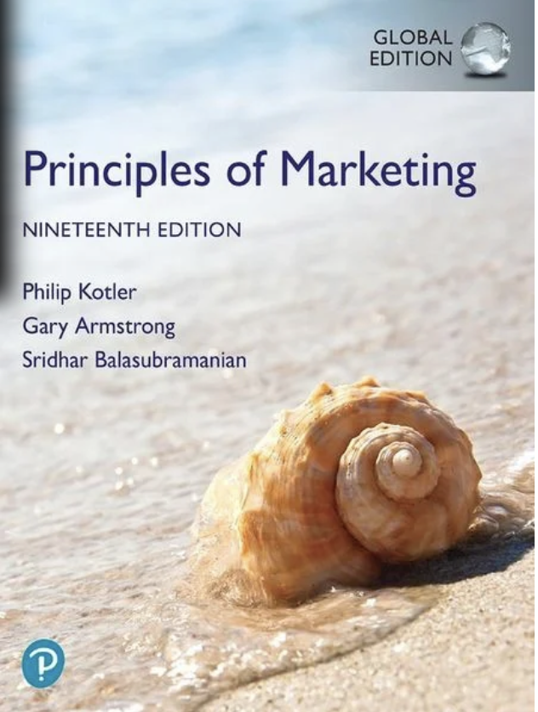
Principles of Marketing
Chapter 7
Marketing Strategy Part 1
Differentiation & Positioning
Copyright © 2018 Pearson Education Ltd. All Rights Reserved.

Slide 3
Learning Objectives
7-1 Define the major steps in designing a customer-driven marketing strategy: market segmentation, targeting, differentiation, and positioning.
7-2 List and discuss the major bases for segmenting consumer and business markets.
7-3 Explain how companies identify attractive market segments and choose a market-targeting strategy.
7-4 Discuss how companies differentiate and position their products for maximum competitive advantage.
7-5 Learn to write a brand positioning statement.

Slide 4
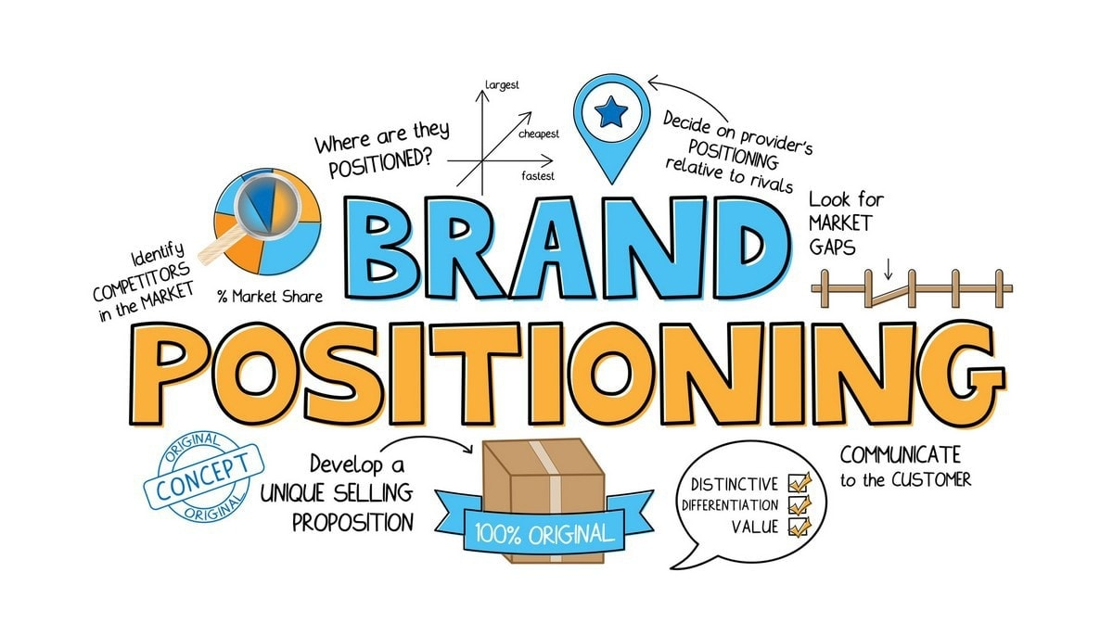
This the Heart of Marketing Strategy !
Segmentation & Targeting
Positioning & Differentiation
Defines what customers are you serving.
Defines your brand value proposition.

Slide 5
Customer-Driven Marketing Strategy
Notes:
Companies today recognize that they cannot appeal to all buyers in the marketplace—or at least not to all buyers in the same way. They must design customer-driven marketing strategies that build the right relationships with the right customers.
Thus, most companies have moved away from mass marketing and toward target marketing: identifying market segments, selecting one or more of them, and developing products and marketing programs tailored to each.
Figure 7.1 shows the four major steps in designing a customer-driven marketing strategy:
Segmentation
Targeting
Differentiation
Positioning
We will discuss each of these steps in turn.

Slide 6
Learning Objective 4
Discuss how companies differentiate and position their brands and products for maximum competitive advantage.

Slide 7
Differentiation and Positioning
4 Steps to Choosing a Differentiation and Positioning Strategy
Identify a set of possible competitive advantages to build a position.
Choose the right competitive advantages (ownable, unique).
Select an overall positioning strategy.
Communicate and deliver the chosen position to the market (so that consumers define the brand as we want them to!).
Notes:
Firms must differentiate their offers by building a unique bundle of benefits that appeals to a substantial group within the segment. Above all else, a brand’s positioning must serve the needs and preferences of well-defined target markets.
For example, although both Dunkin’ Donuts and Starbucks are coffee and snack shops, they target very different customers, who want very different things from their favorite coffee seller. Starbucks targets more upscale professionals with more high-brow positioning. In contrast, Dunkin’ Donuts targets the “average Joe” with a decidedly more low-brow, “everyman” kind of positioning. Yet each brand succeeds because it creates just the right value proposition for its unique mix of customers

Slide 8
Differentiation
What constitutes a competitive advantage?
Notes:
Demographic factors are the most popular bases for segmenting customer groups. One reason is that consumer needs, wants, and usage rates often vary closely with demographic variables. Demographic variables are easier to measure than most other types of variables.
Even when marketers first define segments using other bases, such as benefits sought or behavior, they must know a segment’s demographic characteristics to assess the size of the target market and reach it efficiently.

Slide 9
Differentiation and Positioning
Competitive Advantage
Competitive advantage is an advantage over competitors gained by offering consumers a unique benefit that sets your brand apart by making a tangible difference in your target audience’s life.
Notes:
To build profitable relationships with target customers, marketers must understand customer needs and deliver more customer value better than competitors do. To the extent that a company can differentiate and position itself as providing superior customer value, it gains competitive advantage.
But solid positions cannot be built on empty promises. If a company positions its product as offering the best quality and service, it must actually differentiate the product so that it delivers the promised quality and service. Companies must do much more than simply shout out their positions with slogans and taglines. They must first live the slogan.

Slide 10
Differentiation
Choosing a Differentiation and Positioning Strategy
Your competitive advantages must:
Add value to your clients
Be unique vs your competition
Ideally, challenge something in your industry
Notes:
Product differentiation: Premium audio brand Bose promises “better sound through research—an innovative, high-quality listening experience.”
To find points of differentiation, marketers must think through the customer’s entire experience with the company’s product or service. An alert company can find ways to differentiate itself at every customer contact point.
Through product differentiation, brands can be differentiated on features, performance, or style and design. Thus, Bose positions its speakers on their striking design and sound characteristics. By gaining the approval of the American Heart Association as an approach to a healthy lifestyle, Subway differentiates itself as the healthy fast-food choice.
Some companies gain services differentiation through speedy, convenient, or careful delivery. For example, Jimmy John’s doesn’t just offer fast food; its gourmet sandwiches are “Freaky Fast.”
Firms that practice channel differentiation gain competitive advantage through the way they design their channel’s coverage, expertise, and performance. Amazon.com and GEICO, for example, set themselves apart with their smooth-functioning direct channels.
Companies can also gain a strong competitive advantage through people differentiation—hiring and training better people than their competitors do.
Even when competing offers look the same, buyers may perceive a difference based on company or brand image differentiation. The chosen symbols, characters, and other image elements a brand chooses must be communicated through advertising that conveys the company’s or brand’s personality.

Slide 11
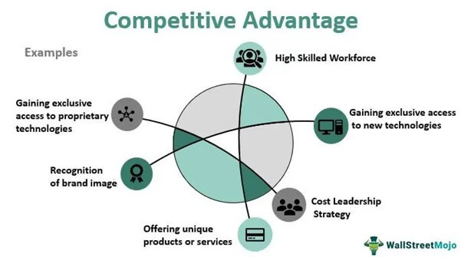
Differentiation
Choosing a Differentiation and Positioning Strategy
Your competitive advantages can be “tangible”:
Price
Product
Technology
Design
Services
Channels
Or “emotional”:
Purpose
Brand Image or Culture
Notes:
Product differentiation: Premium audio brand Bose promises “better sound through research—an innovative, high-quality listening experience.”
To find points of differentiation, marketers must think through the customer’s entire experience with the company’s product or service. An alert company can find ways to differentiate itself at every customer contact point.
Through product differentiation, brands can be differentiated on features, performance, or style and design. Thus, Bose positions its speakers on their striking design and sound characteristics. By gaining the approval of the American Heart Association as an approach to a healthy lifestyle, Subway differentiates itself as the healthy fast-food choice.
Some companies gain services differentiation through speedy, convenient, or careful delivery. For example, Jimmy John’s doesn’t just offer fast food; its gourmet sandwiches are “Freaky Fast.”
Firms that practice channel differentiation gain competitive advantage through the way they design their channel’s coverage, expertise, and performance. Amazon.com and GEICO, for example, set themselves apart with their smooth-functioning direct channels.
Companies can also gain a strong competitive advantage through people differentiation—hiring and training better people than their competitors do.
Even when competing offers look the same, buyers may perceive a difference based on company or brand image differentiation. The chosen symbols, characters, and other image elements a brand chooses must be communicated through advertising that conveys the company’s or brand’s personality.

Slide 12
Differentiation
Competitive Advantage: Product
With DiffusX technology
Notes:
Product differentiation: Premium audio brand Bose promises “better sound through research—an innovative, high-quality listening experience.”
To find points of differentiation, marketers must think through the customer’s entire experience with the company’s product or service. An alert company can find ways to differentiate itself at every customer contact point.
Through product differentiation, brands can be differentiated on features, performance, or style and design. Thus, Bose positions its speakers on their striking design and sound characteristics. By gaining the approval of the American Heart Association as an approach to a healthy lifestyle, Subway differentiates itself as the healthy fast-food choice.
Some companies gain services differentiation through speedy, convenient, or careful delivery. For example, Jimmy John’s doesn’t just offer fast food; its gourmet sandwiches are “Freaky Fast.”
Firms that practice channel differentiation gain competitive advantage through the way they design their channel’s coverage, expertise, and performance. Amazon.com and GEICO, for example, set themselves apart with their smooth-functioning direct channels.
Companies can also gain a strong competitive advantage through people differentiation—hiring and training better people than their competitors do.
Even when competing offers look the same, buyers may perceive a difference based on company or brand image differentiation. The chosen symbols, characters, and other image elements a brand chooses must be communicated through advertising that conveys the company’s or brand’s personality.

Slide 13
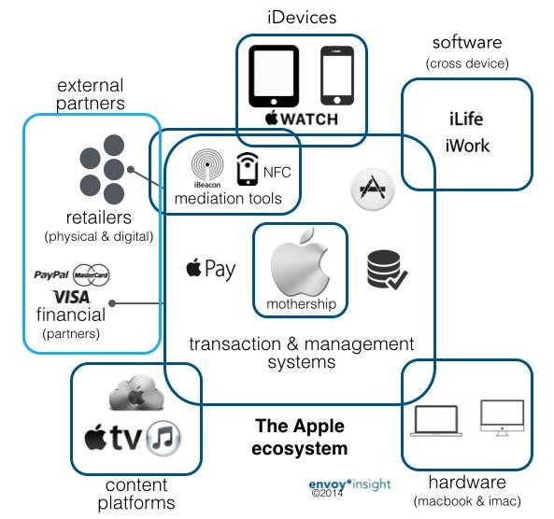
Differentiation
Competitive Advantage: Channels
Through extensive coverage in terms of product offer and markets.
Notes:
Product differentiation: Premium audio brand Bose promises “better sound through research—an innovative, high-quality listening experience.”
To find points of differentiation, marketers must think through the customer’s entire experience with the company’s product or service. An alert company can find ways to differentiate itself at every customer contact point.
Through product differentiation, brands can be differentiated on features, performance, or style and design. Thus, Bose positions its speakers on their striking design and sound characteristics. By gaining the approval of the American Heart Association as an approach to a healthy lifestyle, Subway differentiates itself as the healthy fast-food choice.
Some companies gain services differentiation through speedy, convenient, or careful delivery. For example, Jimmy John’s doesn’t just offer fast food; its gourmet sandwiches are “Freaky Fast.”
Firms that practice channel differentiation gain competitive advantage through the way they design their channel’s coverage, expertise, and performance. Amazon.com and GEICO, for example, set themselves apart with their smooth-functioning direct channels.
Companies can also gain a strong competitive advantage through people differentiation—hiring and training better people than their competitors do.
Even when competing offers look the same, buyers may perceive a difference based on company or brand image differentiation. The chosen symbols, characters, and other image elements a brand chooses must be communicated through advertising that conveys the company’s or brand’s personality.

Slide 14
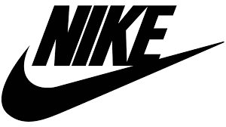
Differentiation
Competitive Advantage: Brand Image
Notes:
Product differentiation: Premium audio brand Bose promises “better sound through research—an innovative, high-quality listening experience.”
To find points of differentiation, marketers must think through the customer’s entire experience with the company’s product or service. An alert company can find ways to differentiate itself at every customer contact point.
Through product differentiation, brands can be differentiated on features, performance, or style and design. Thus, Bose positions its speakers on their striking design and sound characteristics. By gaining the approval of the American Heart Association as an approach to a healthy lifestyle, Subway differentiates itself as the healthy fast-food choice.
Some companies gain services differentiation through speedy, convenient, or careful delivery. For example, Jimmy John’s doesn’t just offer fast food; its gourmet sandwiches are “Freaky Fast.”
Firms that practice channel differentiation gain competitive advantage through the way they design their channel’s coverage, expertise, and performance. Amazon.com and GEICO, for example, set themselves apart with their smooth-functioning direct channels.
Companies can also gain a strong competitive advantage through people differentiation—hiring and training better people than their competitors do.
Even when competing offers look the same, buyers may perceive a difference based on company or brand image differentiation. The chosen symbols, characters, and other image elements a brand chooses must be communicated through advertising that conveys the company’s or brand’s personality.

Slide 15
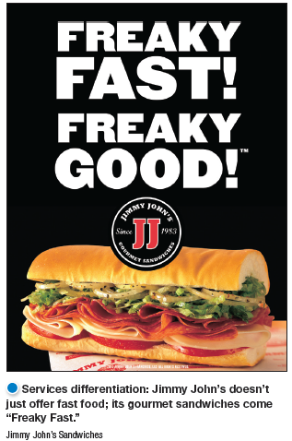
Differentiation and Positioning
Competitive Advantage: Services
Some companies gain services differentiation through speedy, convenient, or careful delivery. For example, Jimmy John’s doesn’t just offer fast food; its gourmet sandwiches are “Freaky Fast.”
Notes:
Product differentiation: Premium audio brand Bose promises “better sound through research—an innovative, high-quality listening experience.”
To find points of differentiation, marketers must think through the customer’s entire experience with the company’s product or service. An alert company can find ways to differentiate itself at every customer contact point.
Through product differentiation, brands can be differentiated on features, performance, or style and design. Thus, Bose positions its speakers on their striking design and sound characteristics. By gaining the approval of the American Heart Association as an approach to a healthy lifestyle, Subway differentiates itself as the healthy fast-food choice.
Some companies gain services differentiation through speedy, convenient, or careful delivery. For example, Jimmy John’s doesn’t just offer fast food; its gourmet sandwiches are “Freaky Fast.”
Firms that practice channel differentiation gain competitive advantage through the way they design their channel’s coverage, expertise, and performance. Amazon.com and GEICO, for example, set themselves apart with their smooth-functioning direct channels.
Companies can also gain a strong competitive advantage through people differentiation—hiring and training better people than their competitors do.
Even when competing offers look the same, buyers may perceive a difference based on company or brand image differentiation. The chosen symbols, characters, and other image elements a brand chooses must be communicated through advertising that conveys the company’s or brand’s personality.

Slide 16
Differentiation and Positioning
Competitive Advantage: People
“If you leave us our money, our buildings and our brands, but take away our people, the company will fail. But if you take away our money, our buildings and our brands, but leave us our people, we can rebuild the whole thing in a decade”.
RICHARD REDWOOD DEUPREE, CEO P&G 1948 - 1959
Notes:
Product differentiation: Premium audio brand Bose promises “better sound through research—an innovative, high-quality listening experience.”
To find points of differentiation, marketers must think through the customer’s entire experience with the company’s product or service. An alert company can find ways to differentiate itself at every customer contact point.
Through product differentiation, brands can be differentiated on features, performance, or style and design. Thus, Bose positions its speakers on their striking design and sound characteristics. By gaining the approval of the American Heart Association as an approach to a healthy lifestyle, Subway differentiates itself as the healthy fast-food choice.
Some companies gain services differentiation through speedy, convenient, or careful delivery. For example, Jimmy John’s doesn’t just offer fast food; its gourmet sandwiches are “Freaky Fast.”
Firms that practice channel differentiation gain competitive advantage through the way they design their channel’s coverage, expertise, and performance. Amazon.com and GEICO, for example, set themselves apart with their smooth-functioning direct channels.
Companies can also gain a strong competitive advantage through people differentiation—hiring and training better people than their competitors do.
Even when competing offers look the same, buyers may perceive a difference based on company or brand image differentiation. The chosen symbols, characters, and other image elements a brand chooses must be communicated through advertising that conveys the company’s or brand’s personality.

Slide 17
Differentiation
Choosing a Differentiation and Positioning Strategy
A competitive advantage should be:
Important: The difference delivers a highly valued benefit to target buyers.
Distinctive: Competitors do not offer the difference, or the company can offer it in a more distinctive way.
Superior: The difference is superior to other ways that customers might obtain the same benefit.
Perceptible: The difference is communicable and visible to buyers.
Preemptive: Competitors cannot easily copy the difference.
Affordable: Buyers can afford to pay for the difference.
Profitable: The company can introduce the difference profitably.
Notes:
Discussion Question
Are you familiar with GEICO advertisements? If so, what is their positioning?
Not all brand differences are meaningful or worthwhile, and each difference has the potential to create company costs as well as customer benefits. A difference is worth establishing to the extent that it satisfies the following criteria:
Important: The difference delivers a highly valued benefit to target buyers.
Distinctive: Competitors do not offer the difference, or the company can offer it in a more distinctive way.
Superior: The difference is superior to other ways that customers might obtain the same benefit.
Perceptible: The difference is communicable and visible to buyers.
Preemptive: Competitors cannot easily copy the difference.
Affordable: Buyers can afford to pay for the difference.
Profitable: The company can introduce the difference profitably.
Many companies have introduced differentiations that failed one or more of these tests. Choosing competitive advantages on which to position a product or service can be difficult, yet such choices may be crucial to success. Choosing the right differentiators can help a brand stand out from the pack of competitors. For example, when Nokia introduced its Lumia 1020 smartphone, it didn’t position the phone only on attributes shared with competing models, such as user interface and speed. It positioned it as a smartphone with a 41 megapixel camera with a “reinvented zoom” and “full HD video” that fits today’s digital lifestyles.

Slide 18
Differentiation and Positioning
4 Steps to Choosing a Differentiation and Positioning Strategy
Identify a set of possible competitive advantages to build a position.
Choose the right competitive advantages (ownable, unique).
Select an overall positioning strategy.
Communicate and deliver the chosen position to the market (so that consumers define the brand as we want them to!).
Notes:
Firms must differentiate their offers by building a unique bundle of benefits that appeals to a substantial group within the segment. Above all else, a brand’s positioning must serve the needs and preferences of well-defined target markets.
For example, although both Dunkin’ Donuts and Starbucks are coffee and snack shops, they target very different customers, who want very different things from their favorite coffee seller. Starbucks targets more upscale professionals with more high-brow positioning. In contrast, Dunkin’ Donuts targets the “average Joe” with a decidedly more low-brow, “everyman” kind of positioning. Yet each brand succeeds because it creates just the right value proposition for its unique mix of customers

Slide 19
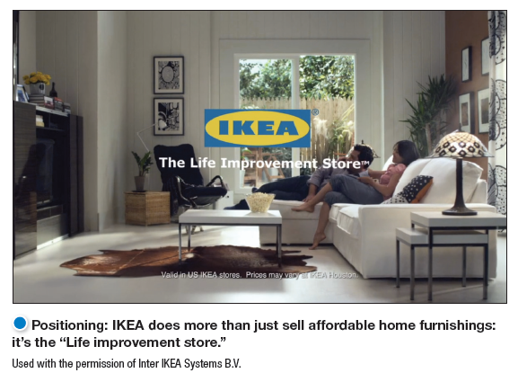
Positioning
Brand Positioning
Brand Positioning refers to the way a brand is defined by consumers (ie. what’s in their heads!) and should capture the unique value that a brand can bring to its customers.
Notes:
Positioning: IKEA does more than just sell affordable home furnishings; it’s the “Life improvement store.”
The company must decide on a value proposition—how it will create differentiated value for targeted segments and what positions it wants to occupy in those segments. The place the product occupies in consumers’ minds relative to competing products is the position. Products are made in factories, but brands happen in the minds of consumers.
Dreft is positioned as the gentle detergent for baby clothes; at IHOP, you “Come hungry. Leave happy.”; at Olive Garden, “When You’re Here, You’re Family.” In the automobile market, the Nissan Versa and Honda Fit are positioned on economy, Mercedes and Cadillac on luxury, and Porsche and BMW on performance.
To simplify the buying process, consumers organize products, services, and companies into categories and “position” them in their minds. A product’s position is the complex set of perceptions, impressions, and feelings that consumers have for the product compared with competing products.
Consumers position products with or without the help of marketers. But marketers do not want to leave their products’ positions to chance. They must plan positions that will give their products the greatest advantage in selected target markets, and they must design marketing mixes to create these planned positions.

Slide 20
Notes:
https://www.youtube.com/watch?v=w0EKS2YfLc0

Slide 21
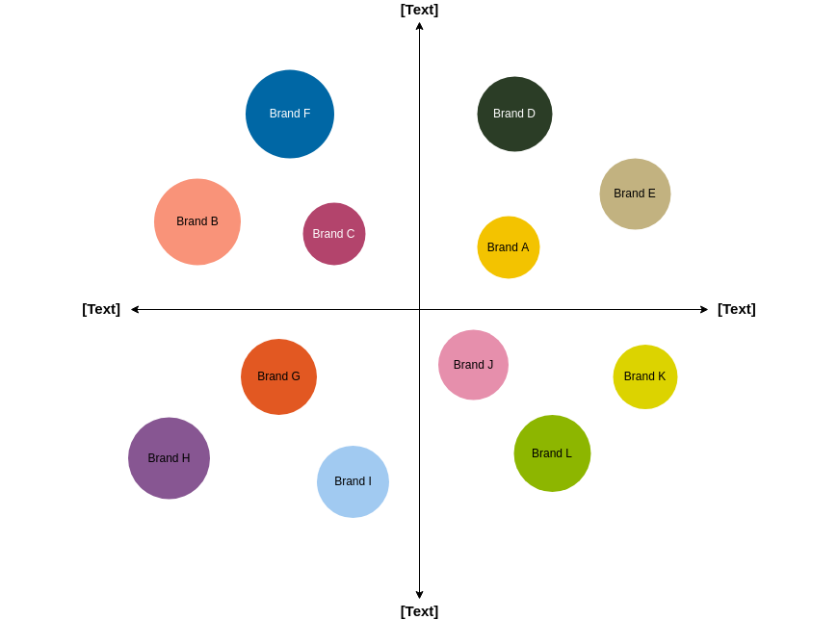
Differentiation and Positioning
Positioning maps show consumer perceptions of marketer’s brands versus competing products on important buying dimensions.
Notes:
In planning their differentiation and positioning strategies, marketers often prepare perceptual positioning maps. The position of each circle on the map indicates the brand’s perceived positioning on two dimensions: price and orientation (luxury versus performance). The size of each circle indicates the brand’s relative market share.

Slide 22
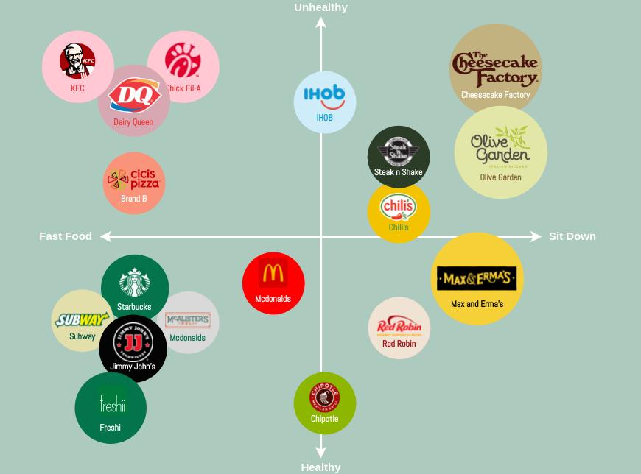
Example: Food

Slide 23
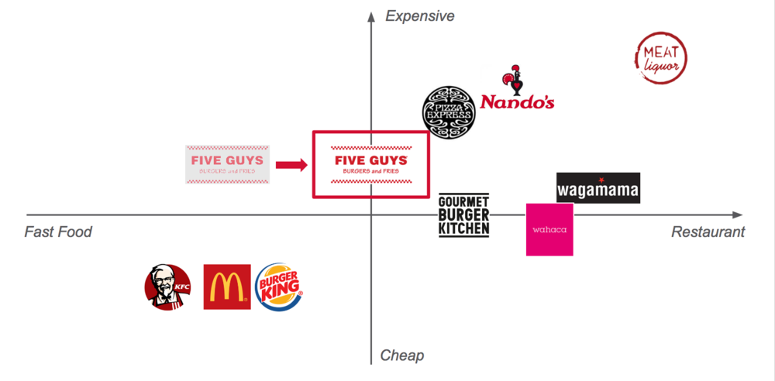
Example: Food

Slide 24
Example: Food

Slide 25
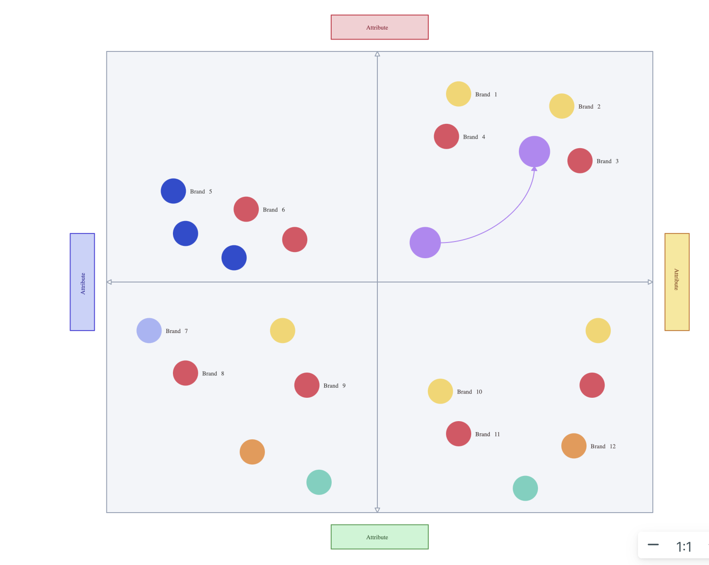
Repositioning
As part of their marketing strategy, brands may look to reposition themselves in a less cluttered place in the market or somewhere where they have stronger differentiation.

Slide 26
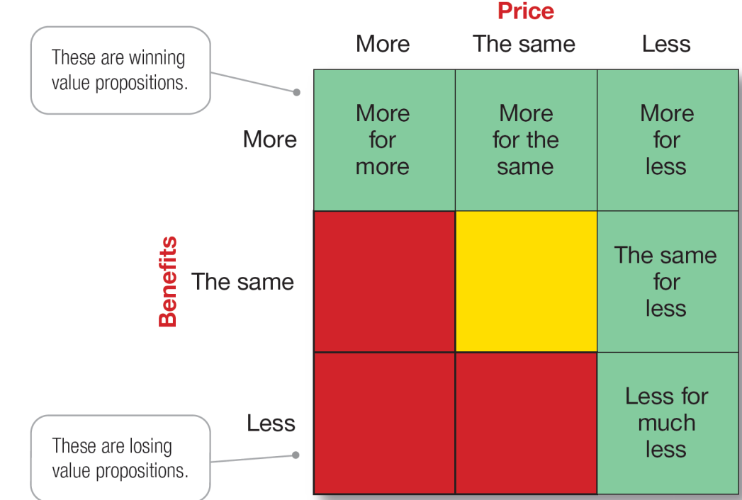
Differentiation and Positioning
Choosing a Differentiation and Positioning Strategy
Brand Value Proposition is the full mix of benefits upon which a brand is positioned.
Notes:
The full positioning of a brand is called the brand’s value proposition—the full mix of benefits on which a brand is differentiated and positioned. It is the answer to the customer’s question “Why should I buy your brand?” BMW’s “ultimate driving machine” value proposition hinges on performance but also includes luxury and styling, all for a price that is higher than average but seems fair for this mix of benefits.
Figure 7.4 shows possible value propositions on which a company might position its products. In the figure, the five green cells represent winning value propositions— differentiation and positioning that gives the company a competitive advantage
More for more: This positioning involves providing the most upscale product or service and charging a higher price to cover the higher costs. Although more for more can be profitable, this strategy can also be vulnerable. It often invites imitators who claim the same quality but at a lower price.
More for the same: Companies can attack a competitor’s more for more positioning by introducing a brand offering comparable quality at a lower price. For example, Toyota introduced its Lexus line with a more for the same value proposition versus Mercedes and BMW.
The same for less: Offering the same for less can be a powerful value proposition—everyone likes a good deal. Discount stores such as Walmart and “category killers” such as Best Buy, PetSmart, David’s Bridal, and DSW Shoes use this positioning.
Less for much less: A market almost always exists for products that offer less and therefore cost less. Few people need, want, or can afford “the very best” in everything they buy. In many cases, consumers will gladly settle for less than optimal performance or give up some of the bells and whistles in exchange for a lower price. For example, Family Dollar and Dollar General stores offer more affordable goods at very low prices.
More for less: Of course, the winning value proposition would be to offer more for less. Many companies claim to do this. And, in the short run, some companies can actually achieve such lofty positions. For example, when it first opened for business, Home Depot had arguably the best product selection, the best service, and the lowest prices compared to local hardware stores and other home improvement chains. Offering more usually costs more, making it difficult to deliver on the “for less” promise in the long run.
All said, each brand must adopt a positioning strategy designed to serve the needs and wants of its target markets. More for more will draw one target market, less for much less will draw another, and so on. Thus, in any market, there is usually room for many different companies, each successfully occupying different positions. The important thing is that each company must develop its own winning positioning strategy, one that makes the company special to its target consumers.

Slide 27
Notes:
https://www.youtube.com/watch?v=wj4H_uvX400

Slide 28
Learning Objective 4
Learn how to write a brand positioning statement.

Slide 29
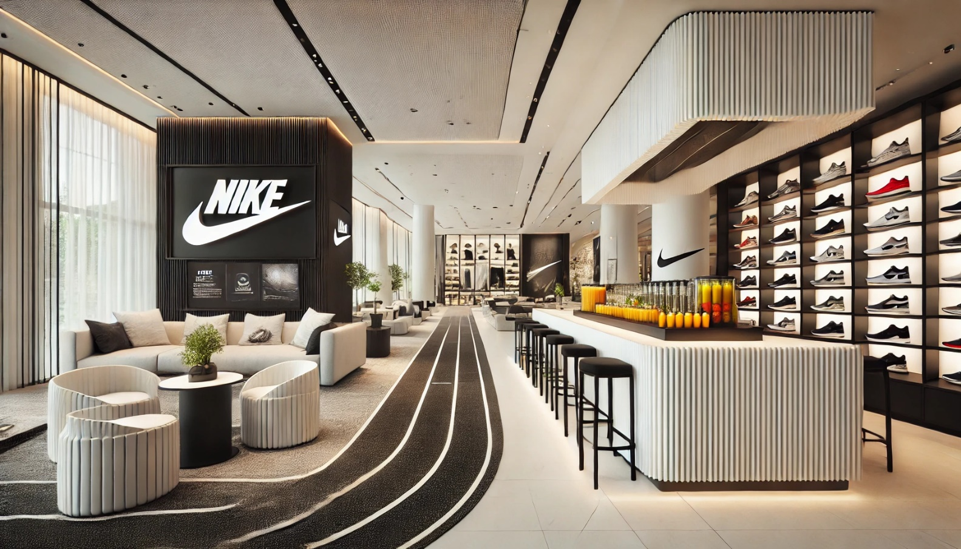
Differentiation and Positioning
Brand Positioning
Brand (or Product) Positioning refers to the way a brand is defined by consumers (ie. what’s in their heads!) and should capture the unique value that a brand can bring to its customers.
Notes:
Positioning: IKEA does more than just sell affordable home furnishings; it’s the “Life improvement store.”
The company must decide on a value proposition—how it will create differentiated value for targeted segments and what positions it wants to occupy in those segments. The place the product occupies in consumers’ minds relative to competing products is the position. Products are made in factories, but brands happen in the minds of consumers.
Dreft is positioned as the gentle detergent for baby clothes; at IHOP, you “Come hungry. Leave happy.”; at Olive Garden, “When You’re Here, You’re Family.” In the automobile market, the Nissan Versa and Honda Fit are positioned on economy, Mercedes and Cadillac on luxury, and Porsche and BMW on performance.
To simplify the buying process, consumers organize products, services, and companies into categories and “position” them in their minds. A product’s position is the complex set of perceptions, impressions, and feelings that consumers have for the product compared with competing products.
Consumers position products with or without the help of marketers. But marketers do not want to leave their products’ positions to chance. They must plan positions that will give their products the greatest advantage in selected target markets, and they must design marketing mixes to create these planned positions.

Slide 30
Differentiation and Positioning
Brand Positioning
Brand (or Product) Positioning refers to the way a brand is defined by consumers (ie. what’s in their heads!) and should capture the unique value that a brand can bring to its customers.
It can then be turned into a brand promise:
what the brand promises to deliver to its customers.
Notes:
Positioning: IKEA does more than just sell affordable home furnishings; it’s the “Life improvement store.”
The company must decide on a value proposition—how it will create differentiated value for targeted segments and what positions it wants to occupy in those segments. The place the product occupies in consumers’ minds relative to competing products is the position. Products are made in factories, but brands happen in the minds of consumers.
Dreft is positioned as the gentle detergent for baby clothes; at IHOP, you “Come hungry. Leave happy.”; at Olive Garden, “When You’re Here, You’re Family.” In the automobile market, the Nissan Versa and Honda Fit are positioned on economy, Mercedes and Cadillac on luxury, and Porsche and BMW on performance.
To simplify the buying process, consumers organize products, services, and companies into categories and “position” them in their minds. A product’s position is the complex set of perceptions, impressions, and feelings that consumers have for the product compared with competing products.
Consumers position products with or without the help of marketers. But marketers do not want to leave their products’ positions to chance. They must plan positions that will give their products the greatest advantage in selected target markets, and they must design marketing mixes to create these planned positions.

Slide 31
Positioning Statements
How to write one
A Brand Positioning statement summarizes company or brand positioning using this form:
To or For (target segment and need) ….
our (brand) is (concept/purpose) ….
that (competitive advantages) ….
Notes:
The company and brand positioning should be summed up in a positioning statement. An example using the above form is shown on the next slide.
The case for the brand’s superiority is made on its points of difference. For example, the U.S. Postal Service ships packages just like UPS and FedEx, but it differentiates its priority mail from competitors with convenient, low-price, flat-rate shipping boxes and envelopes. “If it fits, it ships,” promises USPS.

Slide 32
Differentiation and Positioning
Example: Nike
For athletes in need of high-quality, fashionable athletic wear,
Nike provides top-performing sports apparel and shoes
that are made of the highest quality materials and are the most advanced in the athletic apparel industry.
Brand Promise:
Bring inspiration and innovation to every athlete in the world.
Notes:
Here is a positioning statement example using the popular digital information management application, Evernote: “To busy multitaskers who need help remembering things, Evernote is a digital content management application that makes it easy to capture and remember moments and ideas from your everyday life using your computer, phone, tablet, and the Web.”
Note that the positioning statement first states the product’s membership in a category (digital content management application) and then shows its point of difference from other members of the category (easily capture moments and ideas and remember them later). Evernote helps you “remember everything” by letting you take notes, capture photos, create to-do lists, and record voice reminders, and then makes them easy to find and access using any device, anywhere—at home, at work, or on the go.

Slide 33
Differentiation and Positioning
Example: Nike
https://fabrikbrands.com/branding-matters/brand-strategy/nike-brand-positioning-strategy/

Slide 34
Differentiation and Positioning
Example: Dove
For women who want to look and feel their best,
Dove offers beauty care products that are gentle and nourishing for the skin
that celebrate natural, real beauty.
Brand Promise:
Together, we can change beauty
Notes:
Here is a positioning statement example using the popular digital information management application, Evernote: “To busy multitaskers who need help remembering things, Evernote is a digital content management application that makes it easy to capture and remember moments and ideas from your everyday life using your computer, phone, tablet, and the Web.”
Note that the positioning statement first states the product’s membership in a category (digital content management application) and then shows its point of difference from other members of the category (easily capture moments and ideas and remember them later). Evernote helps you “remember everything” by letting you take notes, capture photos, create to-do lists, and record voice reminders, and then makes them easy to find and access using any device, anywhere—at home, at work, or on the go.

Slide 35
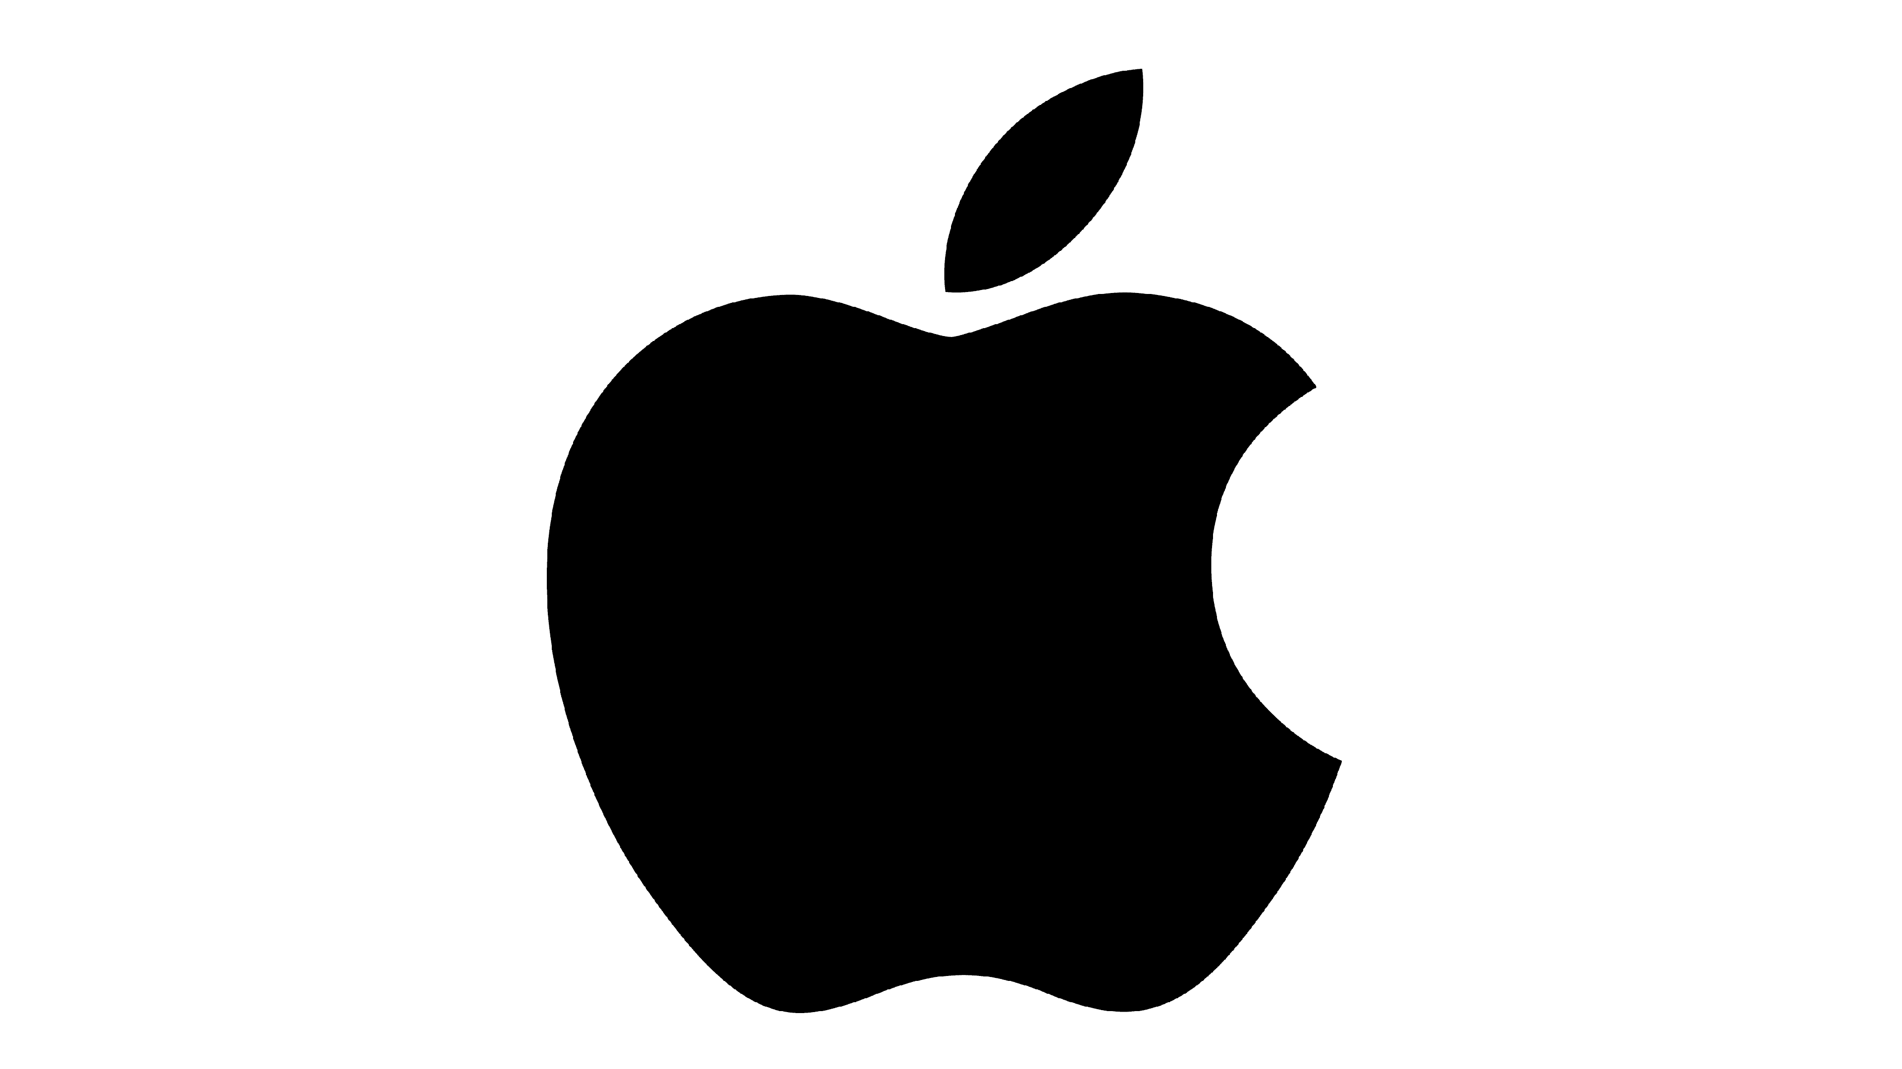
Differentiation and Positioning
Example: Apple
For creative minds who want to challenge the status quo
Apple provides a fully integrated multimedia eco-system
that is easy-to-use and has a great design.
Brand Promise:
Creative tools that advance humankind
Notes:
Here is a positioning statement example using the popular digital information management application, Evernote: “To busy multitaskers who need help remembering things, Evernote is a digital content management application that makes it easy to capture and remember moments and ideas from your everyday life using your computer, phone, tablet, and the Web.”
Note that the positioning statement first states the product’s membership in a category (digital content management application) and then shows its point of difference from other members of the category (easily capture moments and ideas and remember them later). Evernote helps you “remember everything” by letting you take notes, capture photos, create to-do lists, and record voice reminders, and then makes them easy to find and access using any device, anywhere—at home, at work, or on the go.

Slide 36
Differentiation and Positioning
Communicating and Delivering the Chosen Position
Choosing the positioning is often easier than implementing the position.
Establishing a position or changing one usually takes a long time.
Maintaining the position requires consistent performance and communication.
Notes:
Once it has chosen a position, the company must take strong steps to deliver and communicate the desired position to its target consumers. All the company’s marketing mix efforts must support the positioning strategy. Positioning the company calls for concrete action, not just talk. If the company decides to build a position on better quality and service, it must first deliver that position.
Companies must closely monitor and adapt the position over time to match changes in consumer needs and competitors’ strategies. However, the company should avoid abrupt changes that might confuse consumers, and should evolve gradually as it adapts to the ever-changing marketing environment.

Slide 38
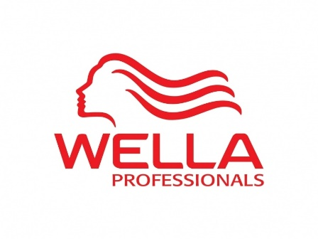
Example: Professional HairCare
Creative Styles
Affordable
Premium
Natural Styles

Slide 39
STYLIST TARGET
Creative stylists who want to be recognised for their craft.
Creative artists
21% of hairdressers

Slide 40
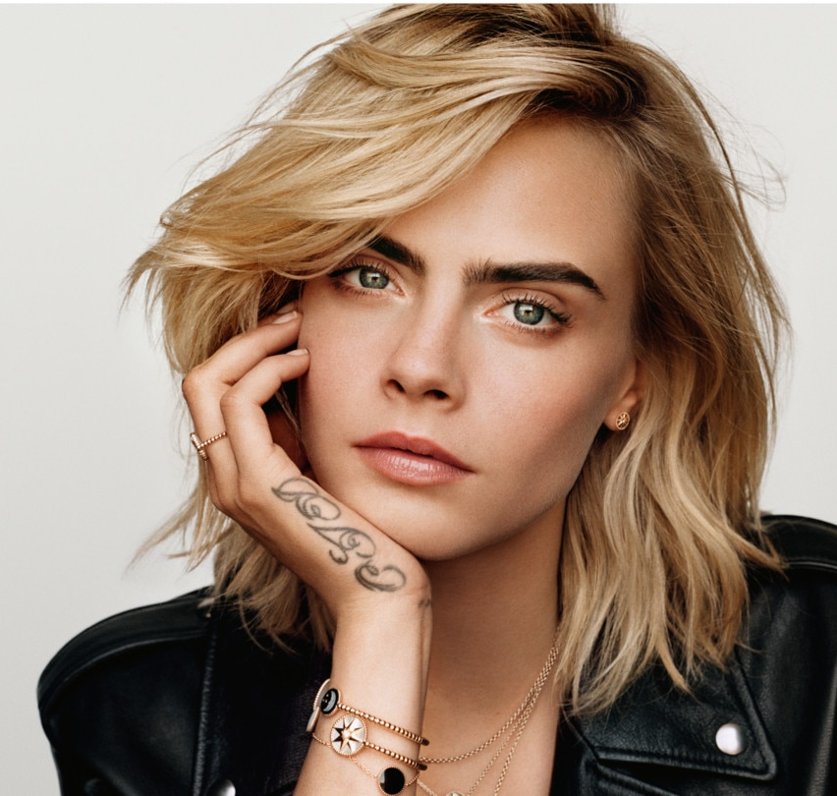
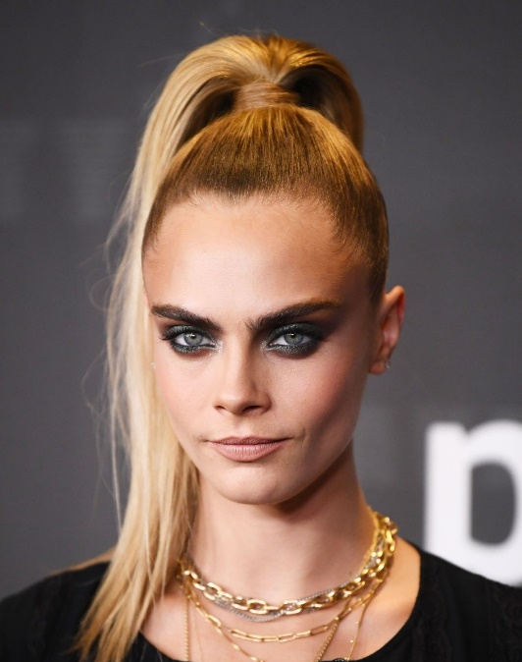
CONSUMER TARGET
Trendsetters who love experimenting with their hair styles.
Millennial Trendsetters & Experience seekers
10% of population

Slide 41
COMPETITIVE ADVANTAGES
VERSATILE & MIXABLE PRODUCTS
ARTISTRY & CREATIVITY
A PASSIONATE TRIBE
Notes:
Our competitive advantages are about:
Superior product performance: professional, versatile, mixable, enabling unlimited possibilities. They can be used by anyone but, just like a formula 1 driver will get the most out of a racing car, a skilled stylist will get the most out of our products.
Artistry and creativity: Sebastian is recognized as the master of the blade and offers education at a high level. Sebastian also inspires the industry via experimenting and creating new hair textures and techniques and very avant-garde looks on stage.
A passionate tribe: Sebastian is a real LOVE BRAND amongst the community of followers. Some stylists have been with the brand since its very beginning and would never leave it. A Sebastian stylist is easily recognizable, at an event, you just see a “sea of black”. The tribe shares a common thirst for learning and elevating their skills and a passion for creativity. They want their creativity be recognized by their peers and Sebastian’s community offers them a platform to do so.

Slide 42
BRAND POSITIONING STATEMENT
For trendsetters who love experimenting with their style,
Sebastian provides creative techniques and versatile products
hat allow you limitless possibilities to express your unique identity.

Slide 43
BRAND PROMISE
Limitless
Hair
Inventions

Slide 46
Key Take-Aways
Differentiation is what makes you different, distinctive or unique.
Brand (or product) positioning is the way the brand is defined by consumers (ie. what’s in their heads!).
Be able to write a product or brand positioning statement.

