Slide 1
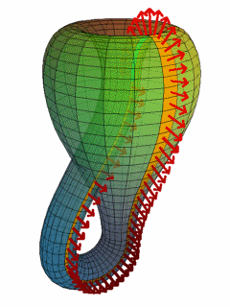
Data formats
Topology
Database structure
Georelationnal-------------------.gdb
Objet--------------------------------.gcm/gcr
Klein bottle
Structure of "flat" vector files
Csv
Shp
Mif/mid
gcm/gcr
Dwg
Dgn
Dxf
Common raster extensions
Geotif
Bil
Erdas
Jpeg…….
MrSID
Jpeg2000
The PostgreSQL/postgis "revolution

Slide 2
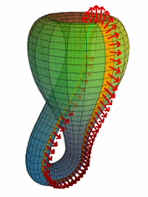
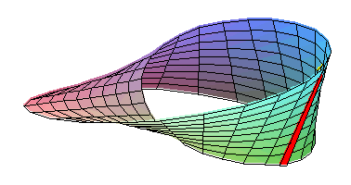
Data formats
Topology where how to get a headache
Topology is a branch of mathematics that focuses on the qualitative properties of objects (mathematics), regardless of any measure. This is done in a topological space that is opposed to a metric space (quantitative, where, for example, distances are defined).

Slide 3
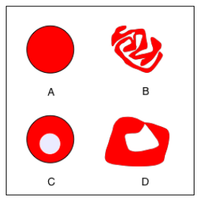
Data formats
homeomorphism
This topological equivalence has been extended to the notions of boundaries and neighbourhoods
A; B and C are topologically equivalent.
Trou
Collage
Relationships can be established by continuous deformation
GIS
A and b are homeomorphic and C and D are not because the change implies a non-continuous action
Mathématics

Slide 4
Data formats
GIS uses ONE topology to account for the proximity between entities. The topological relationships exploited in this context will be adjacency (neighbourhood), connectivity, inclusion and intersection, all within a topological space. But these objects also have a simple or complex geometry in a metric space (they have physical dimensions).
network topology (connectivity relationships)
neighbourhood topology (adjacency / neighbourhood and intersection relationships)
inclusion topology (inclusion relationships)
which is part of the topological space:
a point is located at the end of a line
a point is located on the contour of a polygon;
a point is located within a polygon or region;
a polygon is connected to a line;
an area is simple, not perforated;…….
which is a metric space:
the distance between two points;
the length of a line;
the angle of a line between two points;
the perimeter or surface area of an area;……..

Slide 5
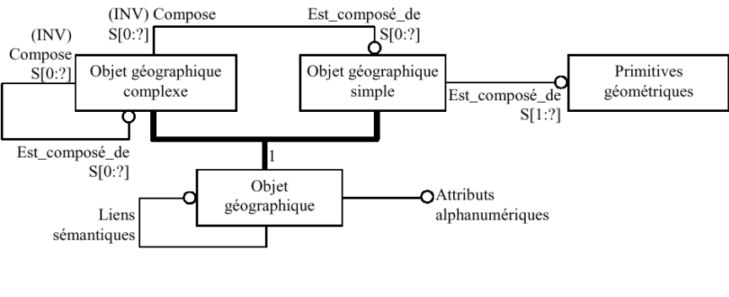
Data formats
Vector geometry..............Geometry encoding

Slide 6
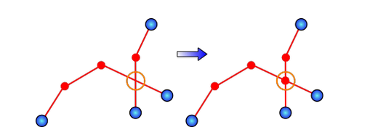
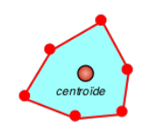
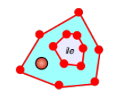
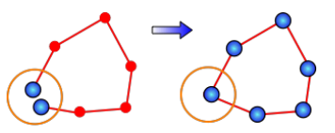
Data formats
Respect for topology
Planar respect of the graph
a surface feature or area is a topological ensemble consisting of a centroid
Vertex sharing
Edges Sharing

Slide 7
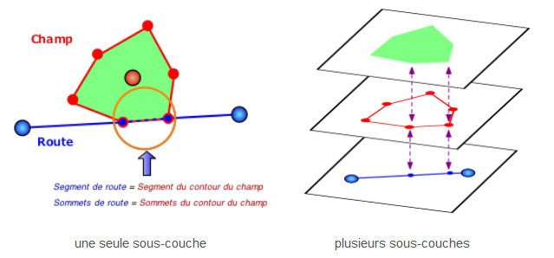
Data formats
An example of the role of topology in the construction of a database

Slide 8
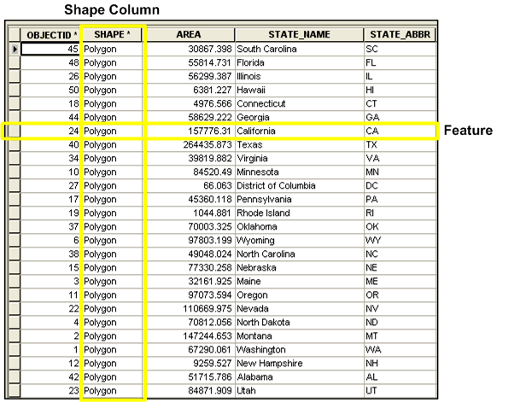
Data formats
Flat file. The shape
. shp
.shx
.dbf
Shape format
Shp is geometry
Dbf is the attribute part.
Shx is the link index
It has become a standard exchange format and is open

Slide 9
Data formats
. shp
.shx
.dbf
Shape format (base)
Additional files
.sbn et .sbx - spatial index of shapes.
.fbn et .fbx - spatial shape index for read-only shapefile
.ain et .aih - index of the attributes of the active fields in a table or in a table of attributes of the theme.
.prj - information on the coordinate system, using the WKT (Well Known Text) format.
.shp.xml - shapefile metadata.
.atx - attribute index file for the dbf file, in the form <shapefile>.<column_name>.atx (ArcGIS 8 and following)
.ixs - Geocoding index for read/write shape files.
.mxs - Geocoding index for read/write shape files (ODB format).
.cpg - Optional file that can be used to specify the code page to identify the character set to be used

Slide 10
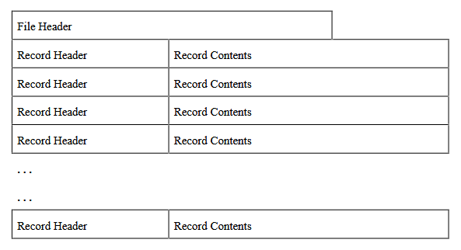
Data formats
The main file (.shp) contains a fixed length file header followed by a variable length file header
Each variable length record consists of a fixed length record header followed by a variable length record content

Slide 11
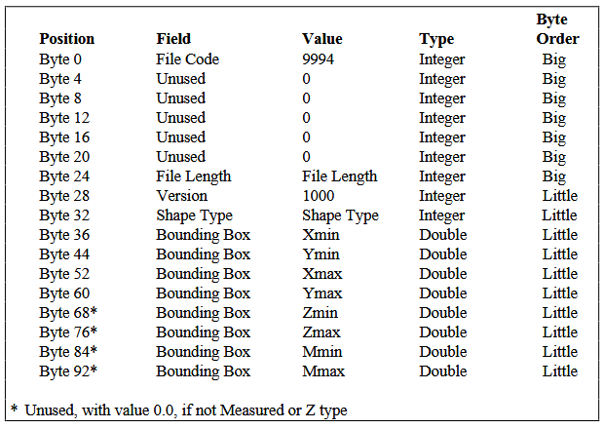
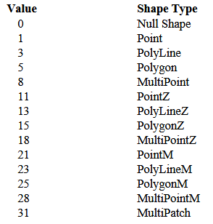
Data formats
Description of the header of the master file

Slide 12
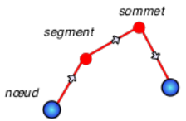
Data formats
The case of polyline
A polyline is an ordered set of vertices that consists of one or more parts. A part is a connected sequence of two or more points. The parts may or may not be connected to each other. The pieces may or may not cross each other.
The Box is the right-of-way box stored in the order Xmin, Ymin, Xmax, Ymax, YmaxNumParts is the number of parts of the polyline (the arcs)NumPoints is the total number of points (vertices)Parts is the index of the first point of a part in the scanning direction (for a directed graph)Points The points of each part of the PolyLine are stored end to end. The points in Part 2 follow the points in Part 1, and so on. The parts table contains the index of the starting point table for each part. There is no delimiter in the point table between the parts. Translated with www.DeepL.com/Translator

Slide 13
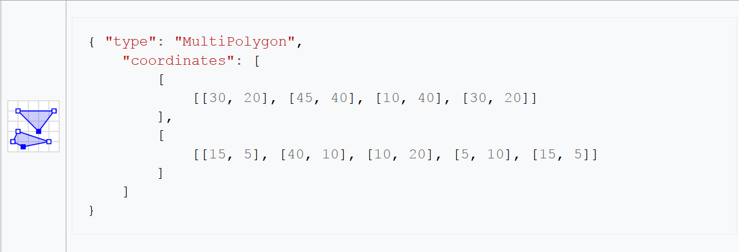
Data formats
GeoJSON
An open format created and developed by internet developers and not by GIS- Men
Simpler, less wordy but also much poorer than the shape
For example, any closed surface is a polygon so no calculation of perimeters (metric space) but also no sharing of geometry (topological space)
There's the TopoJSON that seems to be able to do what the shape does

Slide 14
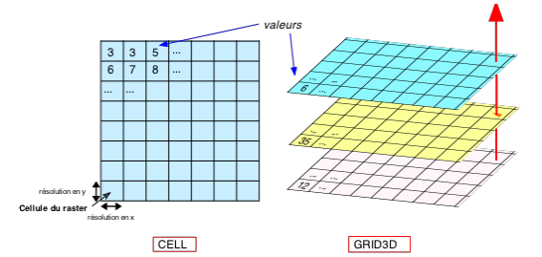
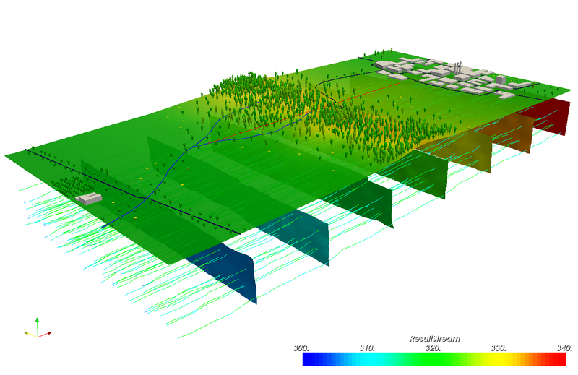
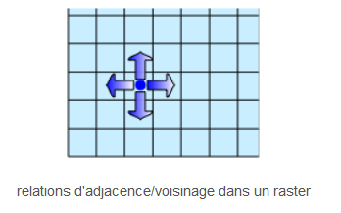
Data formats
Raster topology
Neighbourhood, Adjacency, Connectivity
We can have a 3D extension with voxels

Slide 15
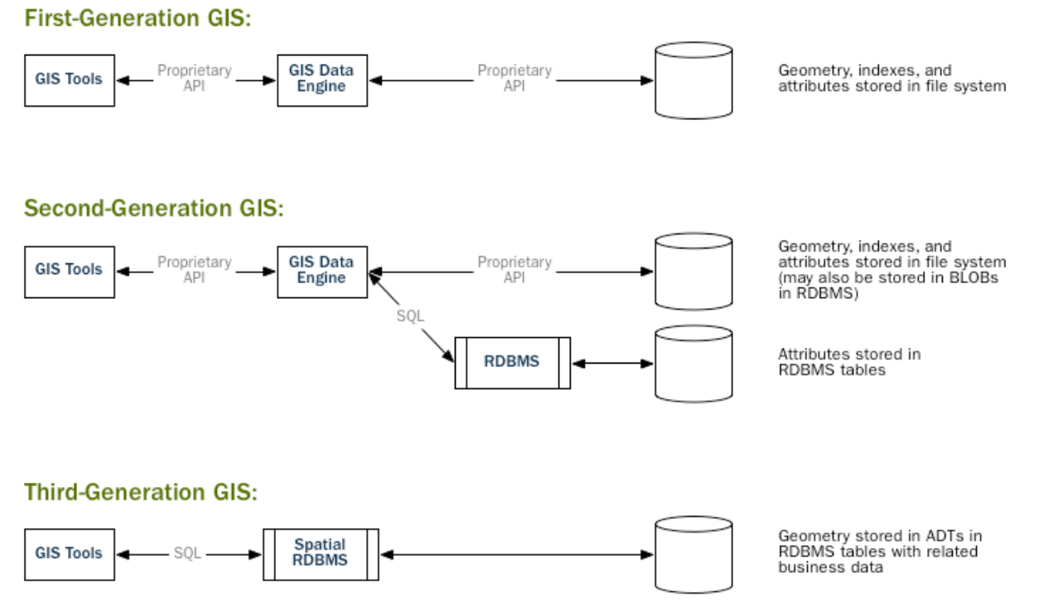
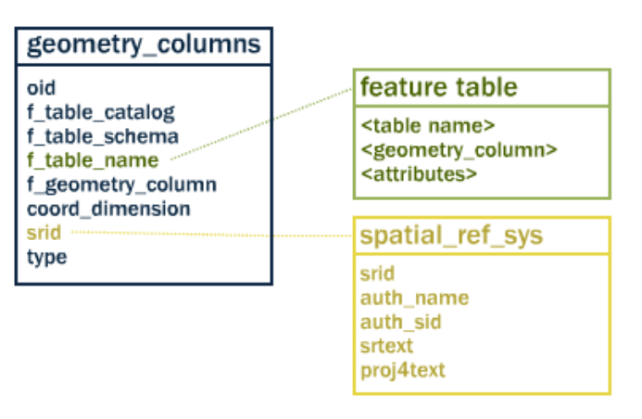
Data formats
The PostgreSQL/postgis "revolution
The mind follows the same approaches as for the shp format with an extension to the relational model that can be used in SQL
The description of the geometry follows a model comparable to GeoJSON

Slide 16
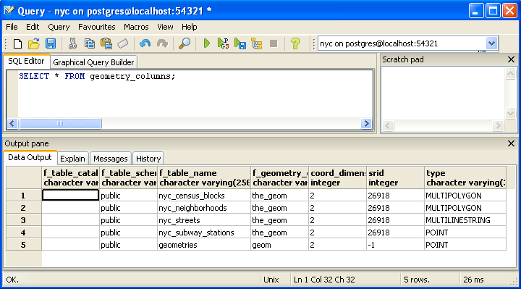
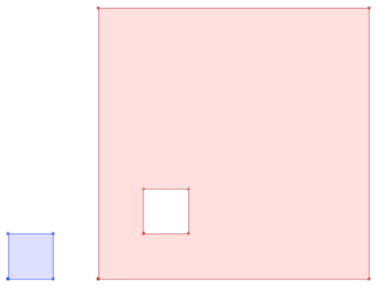
Data formats

